Slide 1
ANALYSING MEDIA CONSUMPTION
Presented on 13/05/2025 by:
Natasha Asiimwe - 24501539
Michael Ayobami Shobowale - 23501800

Slide 2
Outline
Introduction
Dataset Analysis
Hypotheses
Summary
Questions

Slide 3
Introduction
Study explores the relationship between media consumption patterns and behavioral attributes.
Focus areas: fact-checking, trust in media, political orientation, and daily news time.
Dataset analyzed consists of 150 respondents with demographics, media habits, and attitudes.
Analytical methods include ANOVA, Chi-square, and correlation analysis using SPSS.

Slide 4
RESEARCH Hypotheses
The younger a person is, the more their fact checking frequency
The fewer the news sources, the higher the media trust level
Political spectrum position affects fact checking frequency
The number of news sources affects time spent daily on news consumption

Slide 5
Dataset analysis
Variables analyzed: Age, Daily News Minutes, News Sources Count, Political Spectrum, Media Trust, Fact-Checking Frequency.
Recoded variables (Age Group, Political Spectrum, Fact Check Percentage, Media Trust Percentage).
Mean respondent age: 45.5 years; average daily news consumption: 44.2 minutes; average sources: 3.45.
Most common age group: Middle-aged (46%).

Slide 6
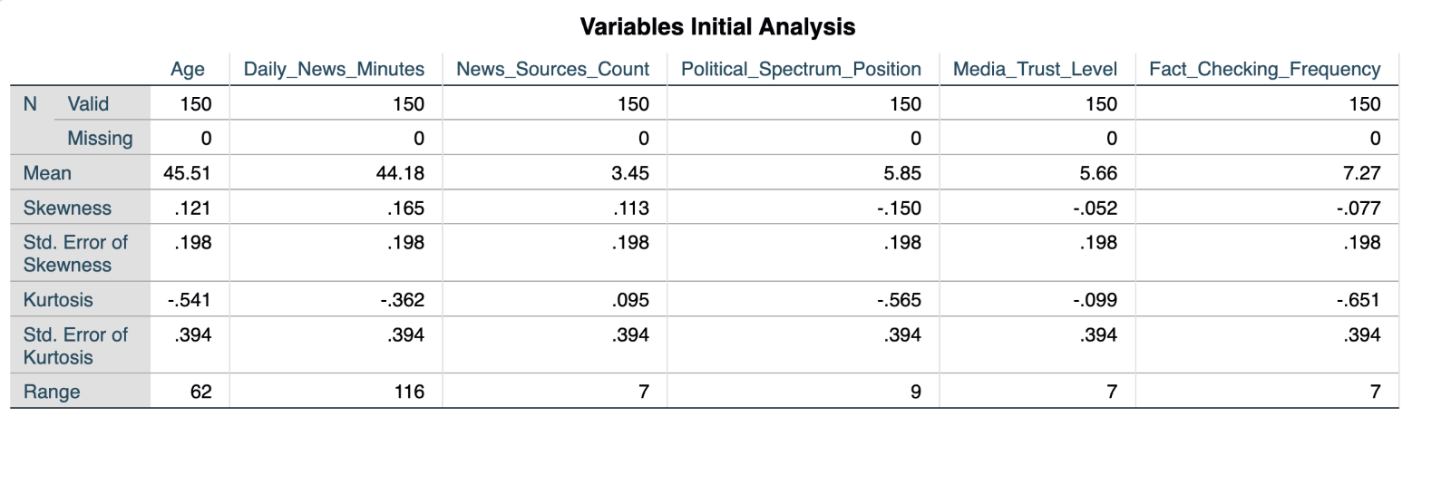
Dataset analysis

Slide 7
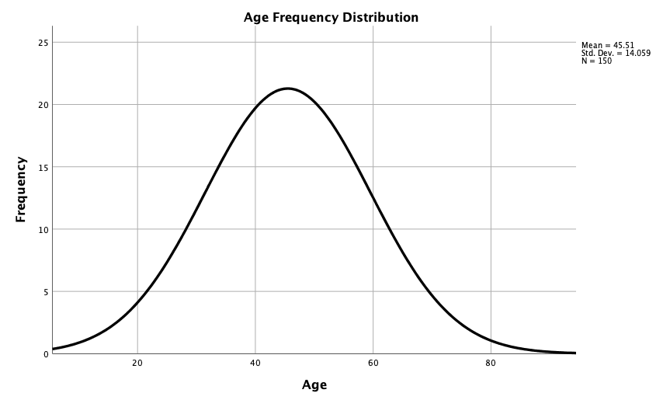
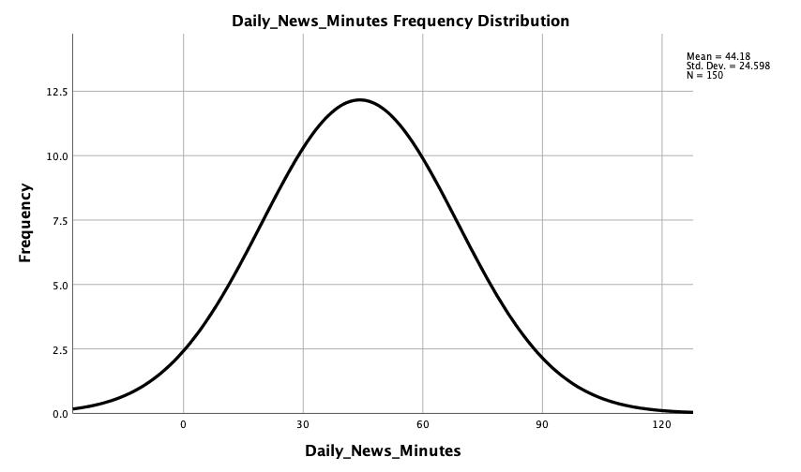
Dataset analysis

Slide 8
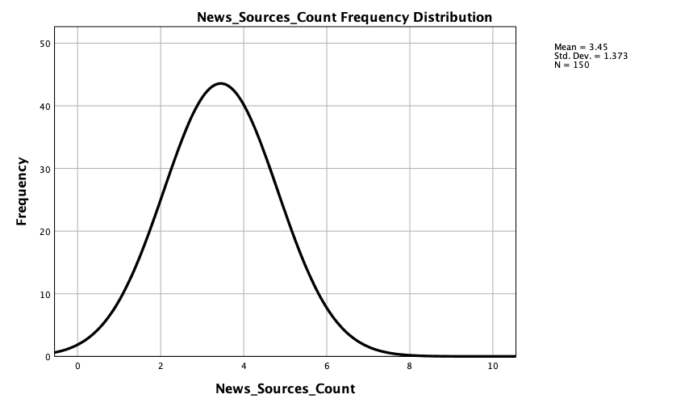
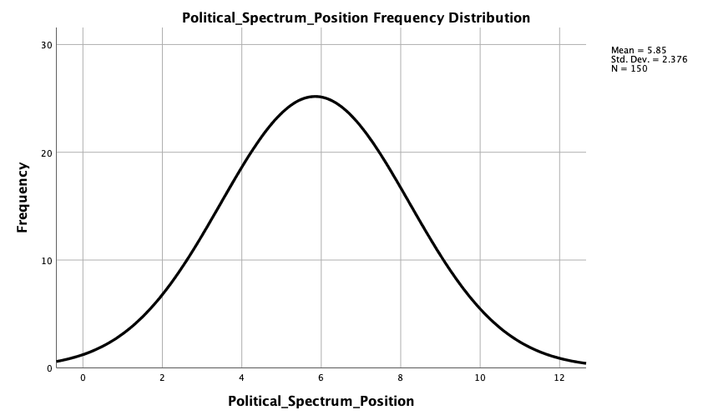
Dataset analysis

Slide 9
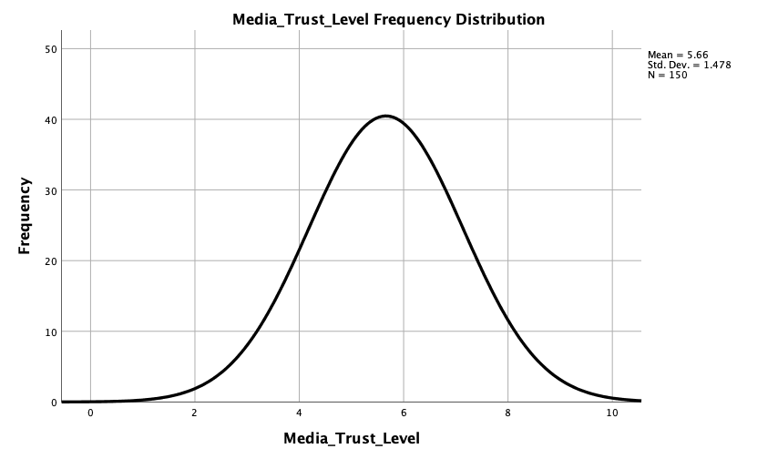
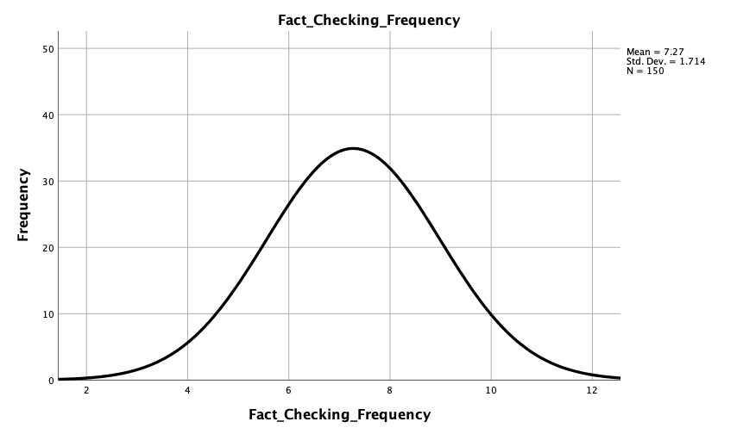
Dataset analysis

Slide 10
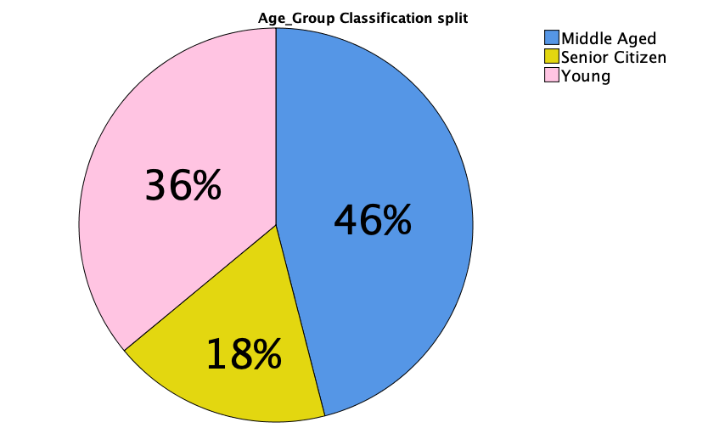
Dataset analysis
Young: 18-40
Middle Age: 41-60
Senior Citizen: 61-80

Slide 11
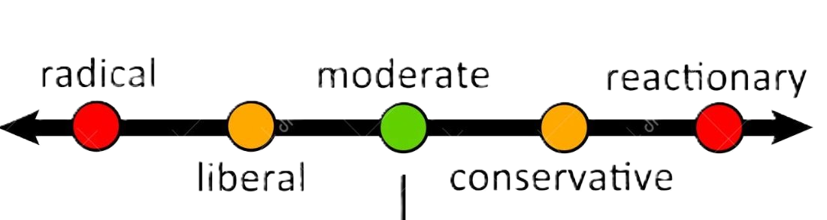
Dataset analysis
Conservative
Middle
Liberal
Political Spectrum Conservative: 1-3
Middle: 4-6
Liberal: 7-10

Slide 12
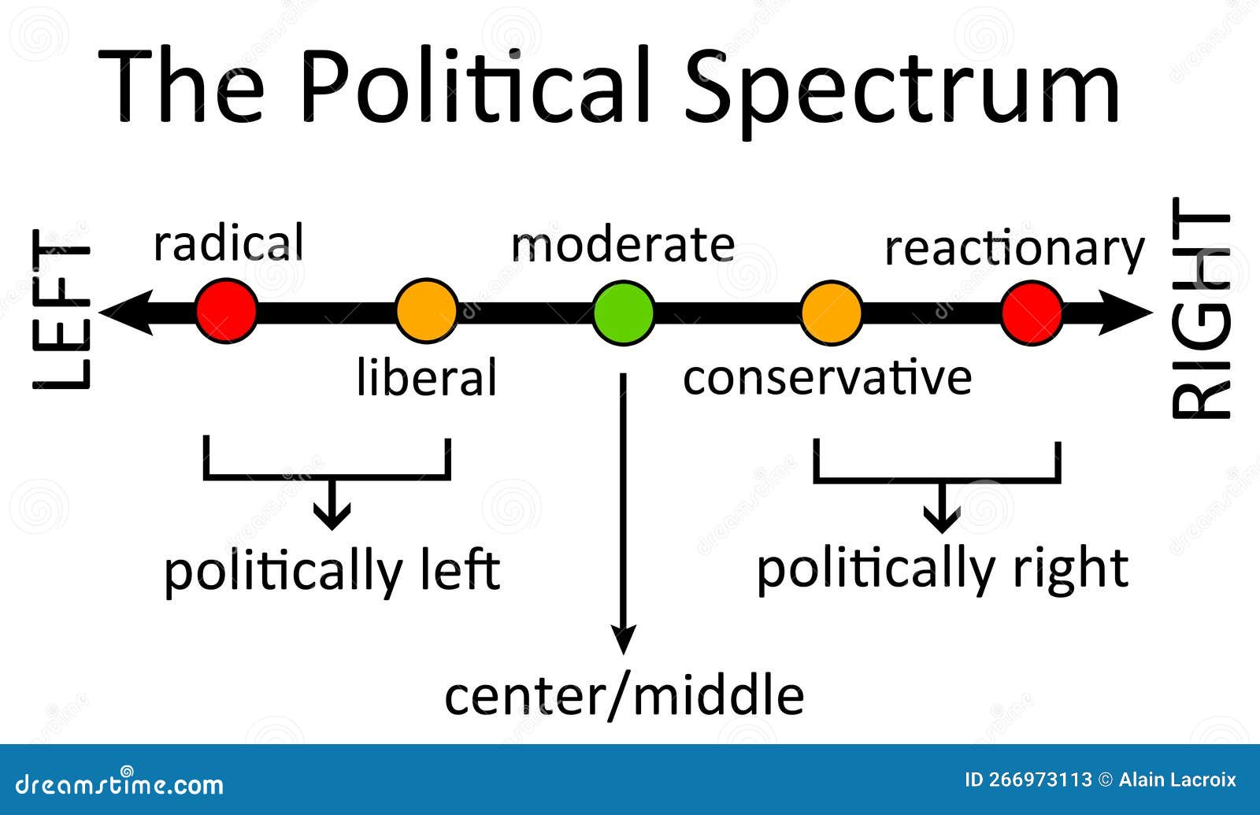
Image of the political spectrum
Source: vrogue.co

Slide 13
The younger a person is, the more their fact checking frequency
Hypothesis: Younger individuals check facts more often.
Results(Compare Means): young adults had the lowest fact-checking rate (M = 68.7%).
Middle-aged (M = 75.36%) and seniors (M = 74.07%) fact-checked more frequently.
Hypothesis rejected due to no significant difference.

Slide 14
The younger a person is, the more their fact checking frequency
Report
Fact Check Percentage
Age Group | Mean | Std. Deviation | % of Total N | Skewness | Std. Error of Kurtosis | Std. Error of Skewness | Kurtosis
Middle Aged | 75.3623 | 17.02763 | 46.0% | -.156 | .570 | .289 | -.928
Senior Citizen | 74.0741 | 18.86373 | 18.0% | -.383 | .872 | .448 | -.177
Young | 68.7037 | 15.90613 | 36.0% | .133 | .639 | .325 | -.234
Total | 72.7333 | 17.14121 | 100.0% | -.077 | .394 | .198 | -.651

Slide 15
The fewer the news sources, the higher the media trust level
Hypothesis: Fewer sources = higher trust.
Results (ANOVA): No significant difference in trust based on news source count (p = .284).
Lowest trust was among those using only 2–3 sources.
Highest trust reported by users with 8–9 sources.
Hypothesis not supported.

Slide 16
The fewer the news sources, the higher the media trust level
ANOVA Table
 |  |  | Sum of Squares | df | Mean Square | F | Sig.
News_Sources_Count * Media_Trust_Level | Between Groups | (Combined) | 16.200 | 7 | 2.314 | 1.241 | .284
 | Within Groups |  | 264.873 | 142 | 1.865
 | Total |  | 281.073 | 149

Slide 17
Political spectrum position affects fact checking frequency
Hypothesis: Political ideology influences fact-checking.
Chi-Square result: No significant association (p = .715).
Most common fact-checking level across all political groups: Level 7.
Hypothesis rejected; fact-checking appears ideologically neutral in this sample.

Slide 18
Political spectrum position affects fact checking frequency
Chi-Square Tests
 | Value | df | Asymptotic Significance (2-sided)
Pearson Chi-Square | 10.626ª | 14 | .715
Likelihood Ratio | 12.717 | 14 | .549
N of Valid Cases | 150
a. 11 cells (45.8%) have expected count less than 5. The minimum expected count is .17.

Slide 19
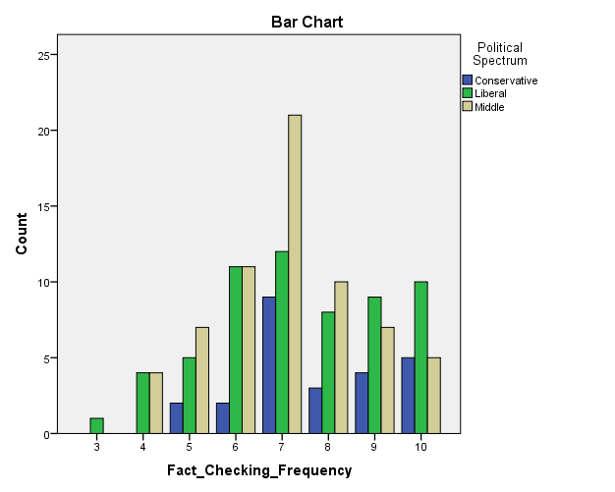
Political spectrum position affects fact checking frequency

Slide 20
The number of news sources affects time spent daily on news consumption
Hypothesis: More sources = more time spent.
Pearson correlation: r = 0.045, p = .584 → No significant relationship.
On average, participants spent 44.2 minutes daily consuming news.
Hypothesis rejected due to weak correlation.

Slide 21
The number of news sources affects time spent daily on news consumption
Correlations
 |  | Daily_News_Minutes
News_Sources_Count | Pearson Correlation (r) | .045
 | Sig. (2-tailed) (p) | .584
 | N | 150

Slide 22
Summary
All four hypotheses rejected based on statistical testing.
Assumptions about age, trust, ideology, and source use were not strongly supported by data.
Highlights the complexity of media behavior and challenges in predicting attitudes based on simple demographics.
Challenges: Issues included uneven sample sizes, non-linear relationships, response bias, and slight data skewness.

Slide 23
QUESTIONs?
Thank you for your attention!
Any questions?

